Slide 1
Thomas Nastas Founder Innovative Ventures Inc. (IVI) Michigan & Moscow (Russia) Profile ‘Scaling Up Investment, Technology & Entrepreneurship’

Slide 2
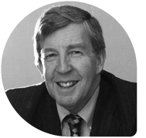
“He Goes Boldly Where Venture Capital Dares Not Go”*
*Intro of Tom Nastas by Doug Miller (Founder, International Private Equity Limited with $7 billion deployed across 25 funds in USA, Europe & Asia). Nastas keynote at the Russian Private Equity Conference, London, 1997

Slide 3
For His Investors & Partners*
Russian Venture Company
Shell Technology Ventures
Kazakhstan Ministry of Education & Science
Nastas’ assignments:
*Analyze the market, define creative financing solutions/TA needed.
“Then work to create venture & quasi-equity funds—new schemes to finance underserved markets, underfinanced entrepreneurs, access new markets & countries.”
Notes:
We investors have had a long and complicated relationship with culture. For a long time, we didn't much notice. The business of business was creating useful things. As long as we were making, say, good hammers, culture didn't really matter. Sure we localized investment funds to local conditions, regulatory framework, nature of the deal flow.
But when we try and solve the valley of death, we need to pay attention to culture and how it shapes the behaviors of investors in the markets we’re trying to impact and how incentives are not the right solution.

Slide 4
Ability to motivate investors, Governments & donors—stakeholders with (often) conflicting objectives—to commit energy and $ to make dreams a reality
$100MM-N. America $15MM-Europe
$315MM-Africa $40MM-Russia
$85MM-Kazakhstan
‘Scale up’ the amount & diversity of $ for SMEs
Yes use multiple strategies & structures to invest + mentor local investors to build a tech portfolio
Selectively expose banks to finance tech + mentor in execution (my bank SME successes in Russia)
Deploy grants for commercialization; results 1st&2nd $22MM invested
In 21 Kazakhstani projects---in just 18 months
Rethink SME creation from university tech & grants to finance international tech transfer
Why Invite Me into Your Project?
Why Invite Me into Your Project?
Manage projects & SMEs to international corporate governance principles & practices
Nastas Member—Board of Directors in 18 SMEs; USA & Emerging Markets. Read my contributions
Access latest thinking in tech & entrepreneurship
I mentor at—Singularity Univ & Unreasonable Institute
*Click links to open & view docs

Slide 5
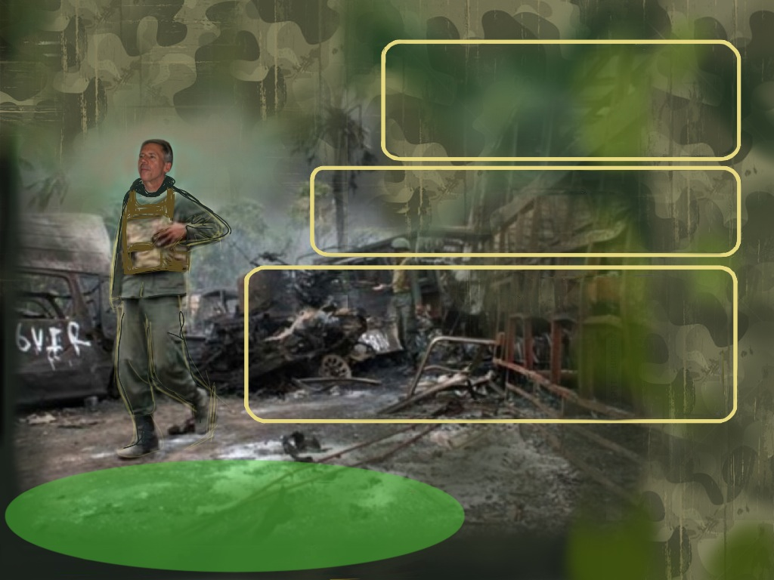
“I’ve Got Your Back”
I lived, invested and worked hand-in-hand with entrepreneurs & investors
I left Michigan in 1992 to Canada & Europe. Then Africa, Kazakhstan & Russia
I financed this expansion myself, with much energy yet few coins in my pocket
No safety net to protect me—much fear, uncertainty & insecurity in execution
I experienced the risks & barriers which your investors & entrepreneurs face—learned to survive then thrive
My successes + failures & detours—gives me the deep understanding of investing, execution and entrepreneurship that you face in countries with:
different economic environments & legal regimes
weak/developing financial markets, especially the high cost & limited amounts of $ from banks & investors
cultural attitudes toward risk & failure—and solutions to overcome
“Nastas’ experiences from the Battlefield are inputs to design new initiatives which balance the interests of all stakeholders for success to occur.”

Slide 6
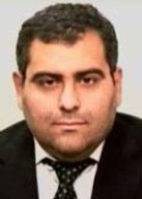
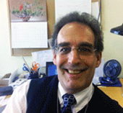
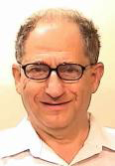
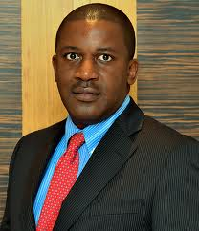
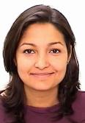
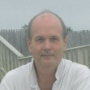
‘Creation of VC Industry in Croatia’ “Tom, I could not resist and just read through it. I found your note extremely helpful & very insightful, read more,” Paulo Correa, World Bank
“I engaged Nastas on several
occasions as our venture capital advisor, read more + recent referral to Africa Dev. Bank.” Al Watkins, Science & Technology Coordinator, World Bank. Read Tech transfer for middle income countries
Slovakia R&D grant scheme, project conducted for World Bank, Itzhak Goldberg, (now retired)
“Tom’s initial role was to drive forward a stalled investment, finish negotiations including deal structuring, deal covenants, Board representation,
read more” Kent Engelmeier + Nastas report-building investment skills of staff in venture capital
Nastas work ‘Succession Fund for S. Africa’ with IFC, invest. officer Salomon Asamoah, now Deputy CEO & CIO, Africa Finance Corp.
Nastas work ‘Africa Enterprise Fund’ $280 MM fund with IFC, investment officer Richard Rutherford, (now retired)
Nastas work ‘East Africa Equity Facility,’ $5 million fund-of-funds for World Bank, Stefano Migliorisi
Nastas manage & execute $85 million Kazakhstan Technology Commercialization Project for Ministry of Education & Science & World Bank (N. Kapil) + grant scheme for Kazak National Innovation Fund
“We knew of Tom’s work as independent director, also he’s been involved in venture investing in the USA, Canada, Europe, Africa, Russia and Kazakhstan. This kind of diversity was sought by Tata & the EBRD to reflect investor expectations, ” read more, Daniel Brooks, CEO, Tata Global Bev. Ltd, Moscow Russia
SME Growth
& Corporate Governance
Nastas work ‘Strategic Plan to Grow the Russian Venture Industry’ for the Russian Venture Company
“Shell Technology Ventures (STV) was a corporate VC investor with Tom Nastas & Innovative Ventures Inc. (IVI) to make investments in Russian technologies read more + summary of work,” Greg Zdun, VP JP Morgan, formerly investment officer with STV
*Click links to open & view docs

Slide 7
What’s in Your Head?
Deal Flow Funds?
Create More Startup Communities? Keep Entrepreneurship Alive?
Cash Flow Funds?
Solve Valley of Death?
Proof-of-Concept Funds?
Diaspora & Mentor Driven Funds?
*Click links to open & view docs

Slide 8
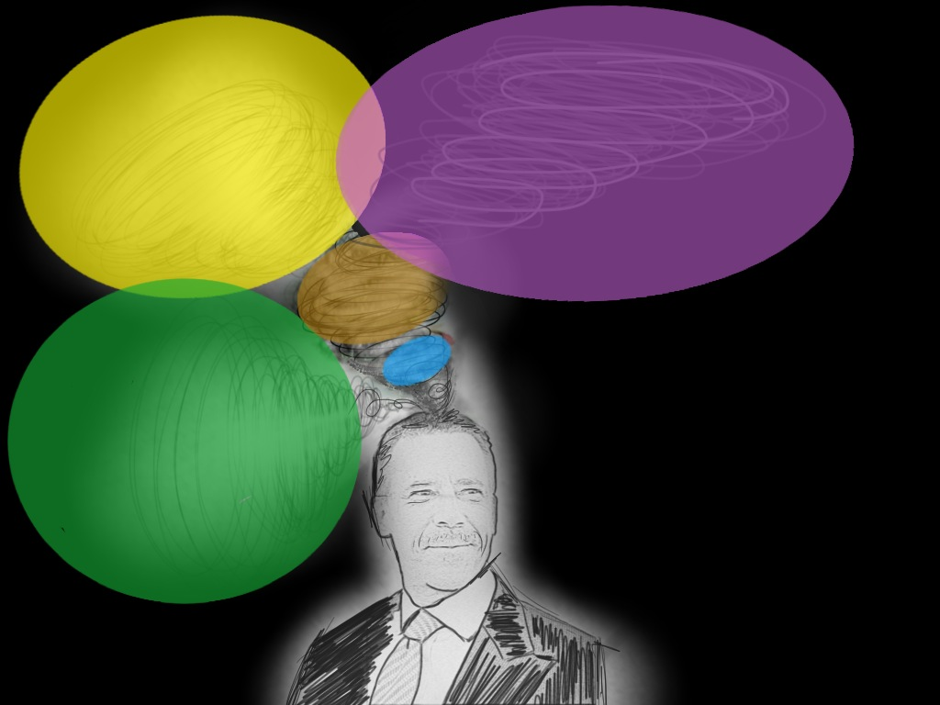
Solution #2: For Investors
Solution #3: For Development Finance Institutions & Govts
Venture initiatives (e.g., deal flow funds) ‘shaped’ to risk behavior of local investors
+
Grant schemes which advance innovation thru commercialization—improve the quality/quantity of IP for market acceptance, e.g., model to $85MM Tech Commercialization Project in Kazakhstan
mentor to build an early stage tech portfolio
Solution #1: For Entrepreneurs
‘Shape’ business models (e.g., clonentrepreneurship) to risk behavior of local investors
+
“Let’s overcome the cultures of risk
mentor entrepreneurs to ‘sell risk—then opportunity’
to unlock & mobilize local $
for more ITE*”
*ITE=Investment, Technology & Entrepreneurship
*ITE=Investment, Technology & Entrepreneurship
*Click link to open & read

Slide 9
Thomas D. Nastas
Tom@IVIpe.com
www.scalingupinnovation.com
www.IVIpe.com
http://www.linkedin.com/in/thomasnastas
Tel. +1.517.899.1432/+7.985.923.4727
Innovative Ventures Inc. Michigan & Moscow (Russia)

Slide 10
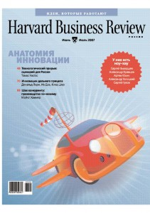
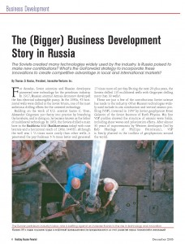
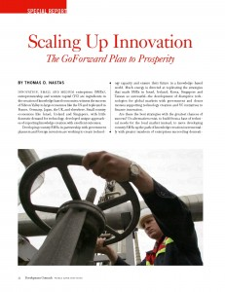
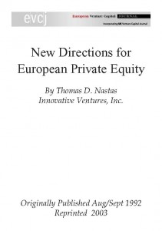
Resources for You*
‘GoForward Plan to Scaling Up Innovation,’ Harvard Business Review, in English, Hungarian, Russian or Spanish+ African Tech Dev. Journal & Russian Investment Review
*Click on icons to open

